Slide 1
Fundamentals of Entrepreneurship
Lecture 3 & 4

Slide 2
What is Entrepreneurship?
Academic Definition (Stevenson & Jarillo)
Entrepreneurship is the process by which individuals pursue opportunities without regard to resources they currently control.
Venture Capitalist (Fred Wilson)
Entrepreneurship is the art of turning an idea into a business.
Explanation of What Entrepreneurs Do
Entrepreneurs assemble and then integrate all the resources needed – the money, the people, the business model, the strategy – to transform an invention or an idea into a viable business.

Slide 3
Why Become an Entrepreneur?
The three primary reasons that people become entrepreneurs and start their own firms
Desire to be their own boss
Desire to pursue their own ideas
Financial rewards

Slide 4
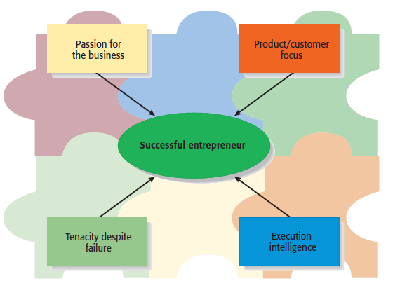
Characteristics of Successful Entrepreneurs
Four Primary Characteristics

Slide 5
Characteristics of Successful Entrepreneurs
Passion for the Business
The number one characteristic shared by successful entrepreneurs is a passion for the business.
This passion typically stems from the entrepreneur’s belief that the business will positively influence people’s lives.
Product/Customer Focus
A second defining characteristic of successful entrepreneurs is a product/customer focus.
An entrepreneur’s keen focus on products and customers typically stems from the fact that most entrepreneurs are, at heart, craftspeople.

Slide 6
Characteristics of Successful Entrepreneurs
Tenacity Despite Failure
Because entrepreneurs are typically trying something new, the failure rate is naturally high.
A defining characteristic for successful entrepreneurs is their ability to persevere through setbacks and failures.
Execution Intelligence
The ability to fashion a solid business idea into a viable business is a key characteristic of successful entrepreneurs

Slide 7
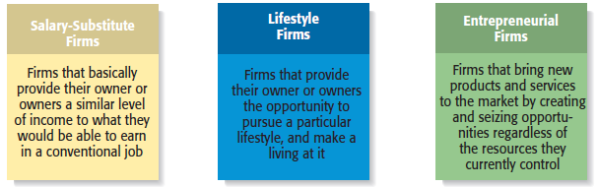
Types of Start-Up Firms

Slide 8
The Entrepreneurial Process
The Entrepreneurial Process Consists of Four Steps
Step 1: Deciding to become an entrepreneur.
Step 2: Developing successful business ideas.
Step 3: Moving from an idea to an entrepreneurial firm.
Step 4: Managing and growing the entrepreneurial firm

Slide 9
The Entrepreneurial Process
Step 1: Deciding to Become an Entrepreneur
This is the first and most personal step — making the decision to pursue entrepreneurship as a career path. It involves recognizing the desire to create something new and accepting the risks and rewards of running one’s own business.
Step 2: Developing Successful Business Ideas
At this stage, the entrepreneur identifies an opportunity and transforms it into a viable business concept. This is where creativity meets market understanding.

Slide 10
The Entrepreneurial Process
Step 3: Moving from an Idea to an Entrepreneurial Firm
In this stage, the entrepreneur turns the idea into a real business. It requires action, planning, and resource mobilization.
Key Activities:
Preparing a business plan – A roadmap that outlines the product, market, strategy, and finances.
Gathering resources – Securing funds, hiring employees, arranging suppliers.
Choosing a legal structure – Sole proprietorship, partnership, or company.
Launching the venture – Starting operations and introducing the product/service to the market.

Slide 11
The Entrepreneurial Process
Step 4: Managing and Growing the Entrepreneurial Firm
Once the firm is up and running, the entrepreneur must focus on management, innovation, and growth. This stage ensures sustainability and long-term success.
Key Activities:
Managing operations – Overseeing daily business activities efficiently.
Marketing and customer relations – Maintaining strong relationships with customers.
Financial management – Controlling costs, reinvesting profits, and expanding strategically.
Innovation and adaptation – Continuously improving products and services.
Growth strategies – Entering new markets, forming partnerships, or diversifying.

